Slide 1
Is Your Customer Experience The Best It Can Be ?
July, 2014
Gary Knee
Executive Vice President, Software Services

Slide 3
Our Evolving Market
The Competitive Landscape is Constantly Changing
Local Telco
Cable Co.

Slide 4
Market Challenges
Challenges
Sales
Mobile Sales force accessing customer data. Tracking Leads and Opportunities, providing quotes. Capturing large and complex sales orders. Easily designing complex and unique service offerings. Establishing new sales channel partners. Visibility into Sales pipeline.
Marketing
Establish new views into service & customer trends for segmentation, service consumption and social networking activity.
Customer Care
Empower front line staff. Intuitive user experience. Ability to track tasks and follow-up items with customers. A 360 degree view of the customer. Up-selling to existing customer.
Operations & IT
Become adept at adjusting to change: wave after wave of new business requirements across all processes and underlying systems. Configuring and Managing complex product offerings.
Ensuring your ROI through better real time visibility and better decision making at levels in the company.
Management
Billing
Reducing risks with high volume usage. Amount of time to run billing. Flexible invoice presentation. Reducing the number of customer inquiries
Notes:
Need a Fly in … Customer Experience !!

Slide 5
Current State of Customer Experience
Provisioning systems
Customer portals
Billing systems
Trouble Ticket Systems
Notes:
I need a chart here that shows a frustrated end user trying to manage their services … voice, internet, TV, etc …
GK : This chart is just talking points that we want the following charts to address
We historically have talked about Billing systems, Trouble Ticket systems, provisioning systems, customer portals as if there are disconnected from each other.. Each with their own dept and responsibility center
That may fit our operational systems fine, but it is not what Todays customer want ..
What do customers want and what do we as partners need to do together to fulfill that need ?
Lets see what the industry has to say about the state of the customer
CB: We can change graph to anything, hold time, frustration. Ultimately the message is the more separate systems you use at your telco, the less your customers will like you.

Slide 6
Customers Respond to Customer Service
40% of mobile customers are willing to change providers for better customer service.
30% of subscribers rated customer care as a primary cause of churn.
The amount of customers willing to switch providers due to poor customer service has increased 20% since last year.
Rural telecom providers are finding a competitive advantage in customer service with churn rates less than half that of larger carriers.
Source: Lightreading, NTCA, Pipeline
6
Notes:
Despite the challenges facing rural wireless providers, their customers tend to be more loyal than those of the larger carriers. Churn rates for survey respondents are well below those of the industry as a whole—41% of survey respondents reported annual churn rates of 10% or less, compared to the FCC-reported industry average of 24% to 30% annually. This speaks to the quality of service provided by these small carriers—while 79% of survey respondents indicated they have a difficult time matching special incentives offered by larger carriers, their customers’ loyalty indicates that non-quantitative factors must also play a role. The significance of the human touch—providing outstanding personalized customer care on an ongoing basis—cannot be overestimated.

Slide 7
Telecom Trend
Switching costs have been minimized.
Competitors offering to pay cancelation fees
Phone number portability
Heavily subsidized handsets
Growth in prepaid sector
It costs much more to gain new customers than it does to retain existing ones .
CSPs that have been practicing CEM for four years or more – are outperforming their competitors.
Source: Pipeline, HeavyReading
Notes:
Acquisition costs for customers ar worth it in the long run .. Ling term value …

Slide 8
Current Customer Management
Lack of consolidated customer data
Delayed response to order handling
Outdated product information
Tracking leads and orders in separate systems
Problem: There is lack of integrated and automated lead to cash system
Notes:
Problem: There is lack of integrated and automated lead cash system
Manual Data Entry – Manual data entry is inefficient and creates potential for error
Multiple Software Platforms – Learning curve associated with each platform. Inefficiency switching between platforms. May lose customer data between platforms or not be able to track touch points within certain platforms ie marketing -> sales -> customer care. From a billing perspective, inconsistent and inaccurate data across diverse systems and processes greatly affect order and service quality, resulting in order fall-out, customer dissatisfaction, and increased competition—all which fuel customer base erosion.
Lack Consolidated Customer Data – No single source of customer data for CSP to make educated business decision from.
Revenue Stagnation
Customer Care Requirements Increasing – As more technical products become available to customers, CSPs are receiving increased calls and service requests. Customers are no longer using a single function of dialing a phone number. Difficulties created by CSP’s existing customer care are adding to customer dissatisfaction leading customers to cancel service and use competing service. CSP’s need a flexible solution to meet increasing customer care needs.

Slide 9
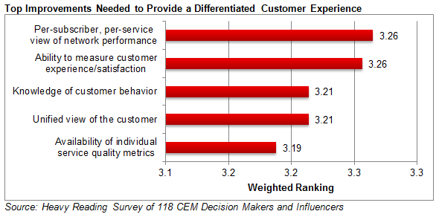
Telecom Trend
Source: Pipeline, HeavyReading

Slide 10
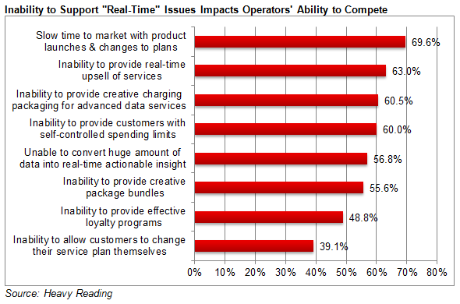
Customer Engagement = Sales Opportunity!
Source: Pipeline, HeavyReading

Slide 11
A 360° View of the Customer
Data = Knowledge
Knowledge can provide: increased customer satisfaction and
improved sales
A 360°view involves understanding the customer from lead to cash:
Before: A clear and concise view of the Subscriber history. This includes past service issues, subscriptions, campaign exposure.
During: Current Subscriber information, including contact information, current products and services, pending orders, outstanding service issues and more.
After: Ability to collect data, report on it and enable actions that can prevent churn, increase take rates on new products and services. Ability to rapidly develop and push targeted campaigns.

Slide 12
What Does Customer Data Mean for You?
Terabytes of customer data are useless unless you have a way to analyze it.
Problems that can be resolved by analyzing big data:
Targeted offers
Automated campaign management
Churn prediction
Proactive customer care
Notes:
Heavy Reading expects the big data technology and services market (for the communications service provider sector) to grow from $1.95 billion in 2013 to $9.83 billion in 2020. Helps convey value of big data and the value associated with analyzing that data. This represents a total compound annual growth rate (CAGR) of 26%. Breakout CAGR growth between software, hardware and services are: software will grow at 29.3% CAGR; hardware will grow at 22.8% CAGR; and services will grow at 26.8% CAGR.
http://www.lightreading.com/spit-(service-provider-it)/analytics-big-data/suppliers-gear-up-for-big-data-gold-rush/a/d-id/708488

Slide 13
Turn Data Into Knowledge
32% of enterprise decision-makers stated they can’t answer customer questions accurately or consistently because they don’t have access to the right data.
51% of customer-service strategy decision-makers stated they struggle with data challenges
Source: Pipeline
Notes:
http://media.pipeline.pubspoke.com/files/asset/615/PipelineMarch2013_A10.pdf

Slide 14
Adoption Segments
Early Adopter
Has already set the pace in CEM in its market to establish itself as the leading market brand
Fast Follower
Needs to catch up with the leading benchmark for CE in its market to improve subscriber numbers and profitability.
Mainstream Adopter
Needs to maintain its business on a sound financial footing which means understanding its customers better and refining how and what it sells them

Slide 15
Value of the Customer Experience
Even in a negative economy, customer experience is a high priority for consumers, with 60% often or always paying more for a better experience. Source: Harris Interactive, Customer Experience Impact Report
81% of companies with strong capabilities and competencies for delivering customer experience excellence are outperforming their competition Source: Peppers & Rogers Group, 2009 Customer Experience Maturity Monitor
Out of best in class companies: 91% provide customers the ability to track issues over the web, 57% measure support center success across email, chat, web, and voice, and 62% use integrated voice response (IVR) Source: Aberdeen Group
70% of customer experience management best in class adopters use customer feedback to make strategic decision. 50% of industry-average organizations and 29% of laggards do. Source: Aberdeen Group, Customer Experience Management: Engaging Loyal Customers to Evangelize Your Brand

Slide 16
Value of the Customer Experience
Top three drivers for investing in Customer Experience Management:
Improve customer retention (42 %)
Improve customer satisfaction (33 %)
Increase cross-selling and up-selling (32 %) Source: Aberdeen report – Customer Experience Management: Engaging Loyal Customers to Evangelize Your Brand
Dissatisfied customers will tell between 9 and 15 people about their experience. 13% of dissatisfied customers tell more than 20 people. Source: White House Office of Consumer Affairs, Washington, DC
86% of consumers quit doing business with a company because of a bad experience, up from 59% 4 years ago Source: Harris Interactive, Customer Experience Impact Report
For every customer complaint, there are 26 other customers who have remained silent Source: Lee Resource Inc

Slide 17
Value of the Customer Experience
Customer churn is caused by customer feelings of poor treatment 68% of the time Source: TARP
It takes 12 positive service experiences to make up for one negative experience Source: “Understanding Customers” by Ruby Newell-Legner
91% of unhappy customers will not willingly do business with your organization again Source: Lee Resource Inc.
Happy customers who get their issue resolved tell about 4 to 6 people about their experience. Source: White House Office of Consumer Affairs, Washington, DC
Attracting a new customer costs 5 times as much as keeping an existing one Source: Lee Resource Inc.

Slide 18
Enhanced Customer Experience
360 view of the customer
Trouble Ticket
View order
View leads
Balance Management
Invoices
Change orders
The service request is routed to the best available agent.
Service requests come in via phone, web, or other channels.
The knowledge base is searched and solutions are suggested.
Notes:
Increase sales by quickly identifying upsell opportunities.
Expand your product portfolio, using subscriber analytics to guide product and service development.
Reduce churn by providing a superior customer experience.
Anticipate customer expectations to increase/decrease capacity where needed.
Quickly identify service issues and identify how they will affect your customers.
Improve operational efficiency with live operational data.
Trouble ticket management
View orders
View leads
Balance Management
Service change/change orders

Slide 19
Integrated Systems = Better Customer Experience
Dynamic industry specific software now enables a direct path from lead to cash.
Auto-provisioning and self-serve product catalogs enable leads complete the sales cycle in a single touch point.
Automatic response to client interactions increases customer experience without increase work load on CSPs.
Decrease cost of customer acquisition.
Serve tailored marketing that is unique to each customer’s needs.
Loyalty programs decreasing churn and increasing customer retention.
M2M transaction creating efficiency.
24x7 up time increasing availability and customer support.

Slide 21
Improved Organizational Efficiency
True 360° Visibility
Higher
Productivity
Greater Sales Efficiency
Improved Close Rates
Improve decision-making with 360° visibility into accounts, leads, opportunities and cases across the organization
Spend more time for selling
with better collaboration and consistency across the sale organization
Shorten sales cycles via enforceable workflows and more accurate customer data
Increase revenue by optimizing sales resources and processes via repeatable best practices

Slide 22
Questions
Gary Knee – Executive Vice President, Software Services
(713) 351-5206
Gary.Knee@chrsolutions.com

